Slide 1
Voting Project
BY
SHAFIQ SSENTONGO
Shafiq Ssentongo

Slide 2
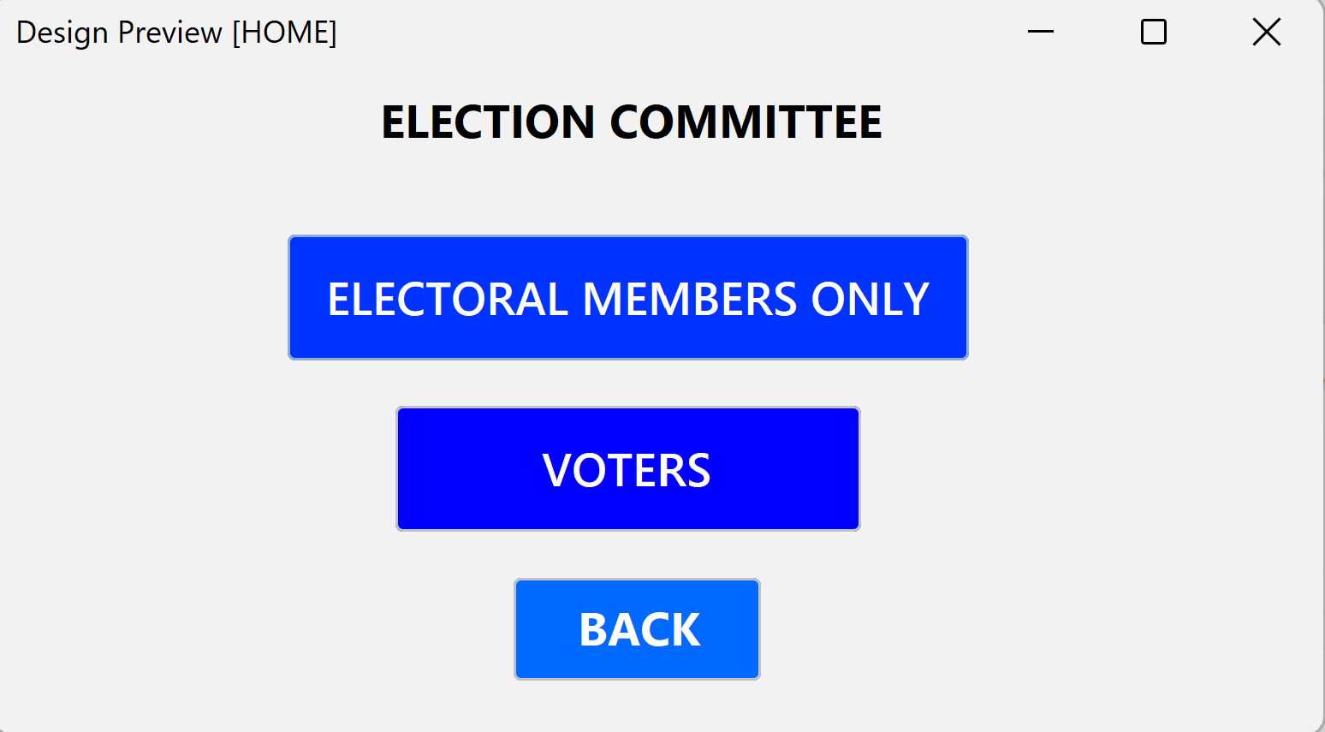
Introduction
The Voting System was created to develop a secure, efficient and user friendly platform for conducting elections.
The primary objective is to overcome most modern day challenges associated with the old voting methods.
Below is a preview of the Home Page.

Slide 3
1
Old Voting Methods

Slide 4
Challenges with the Old Voting Methods.
Human Errors: e.g. Manual handling of ballots while Tallying hence affecting election outcomes.
Accessibility: Some individuals cant access areas where voting is taking place, like people with disabilities, or people that live far from the voting stations.
Inefficiency and Delays: Counting paper ballots can be time consuming and this is leads to delays hence delaying the voting process.
Security Risks: Physical Ballots are easy to be tampered with which can comprise the election or they can easily get lost.
Global Warming: Making of paper leads to cutting down of trees.

Slide 5
Solutions offered by my System
Efficiency: Automated counting, Fast and quick.
Accuracy: Eliminating Human Error.
Accessibility: Easily used from around the globe. (Online Access).
Security: My system uses advanced encryption techniques to ensure only authorised people vote.
Using this system means Carbon dioxide emission is reduced hence reducing the rate of Global warming.

Slide 6
2
Module Description

Slide 7
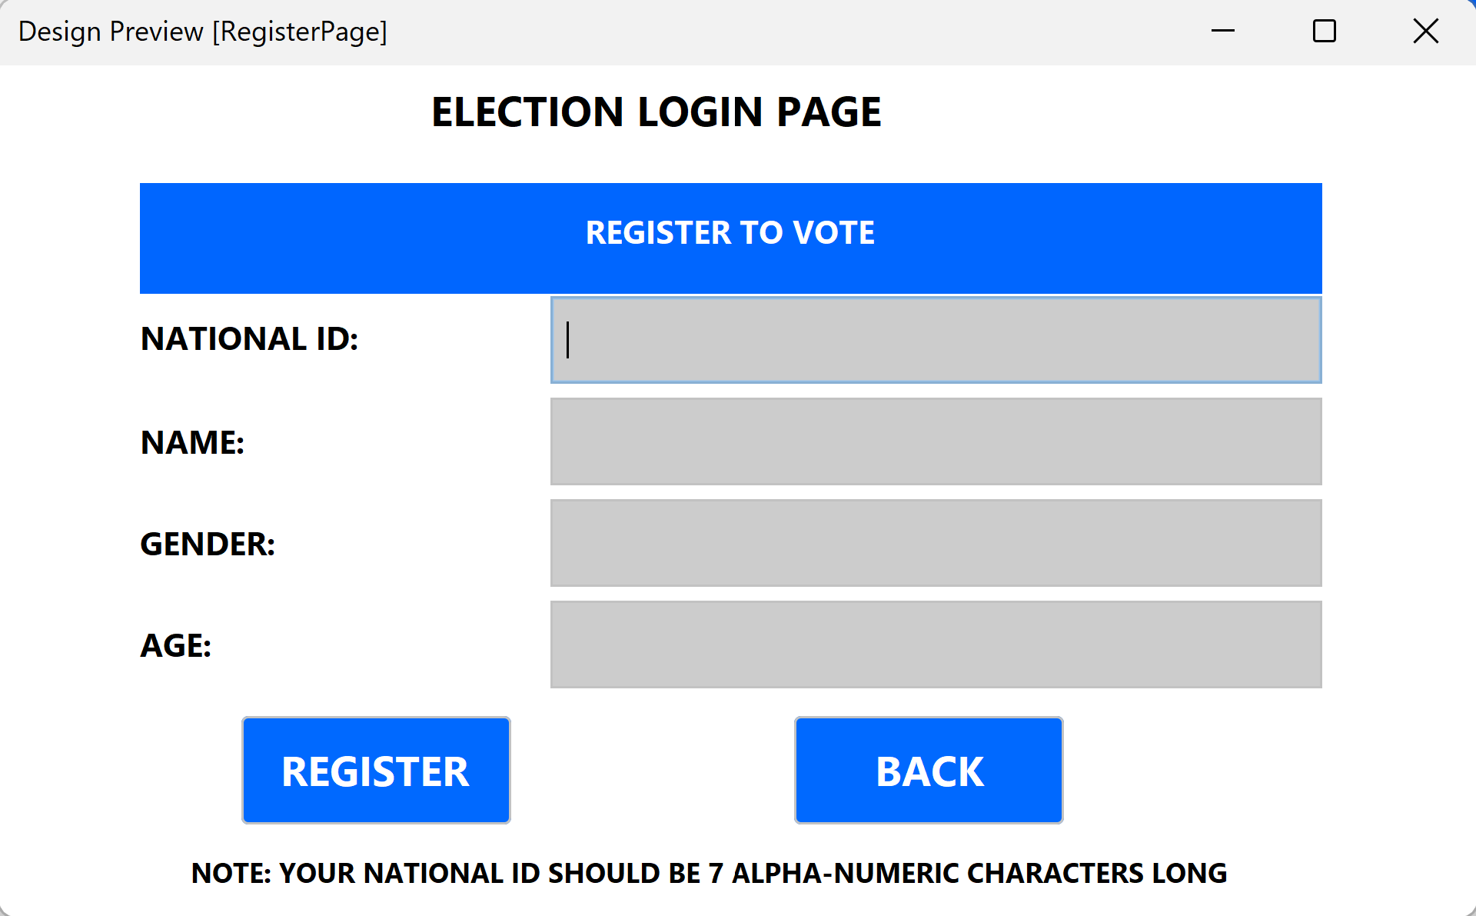
User Interface Model
The voter register is a simple and clear layout as you can see on the right for easy usage.
The Register button runs an input SQL Statement which adds each voter to the secure database.

Slide 8
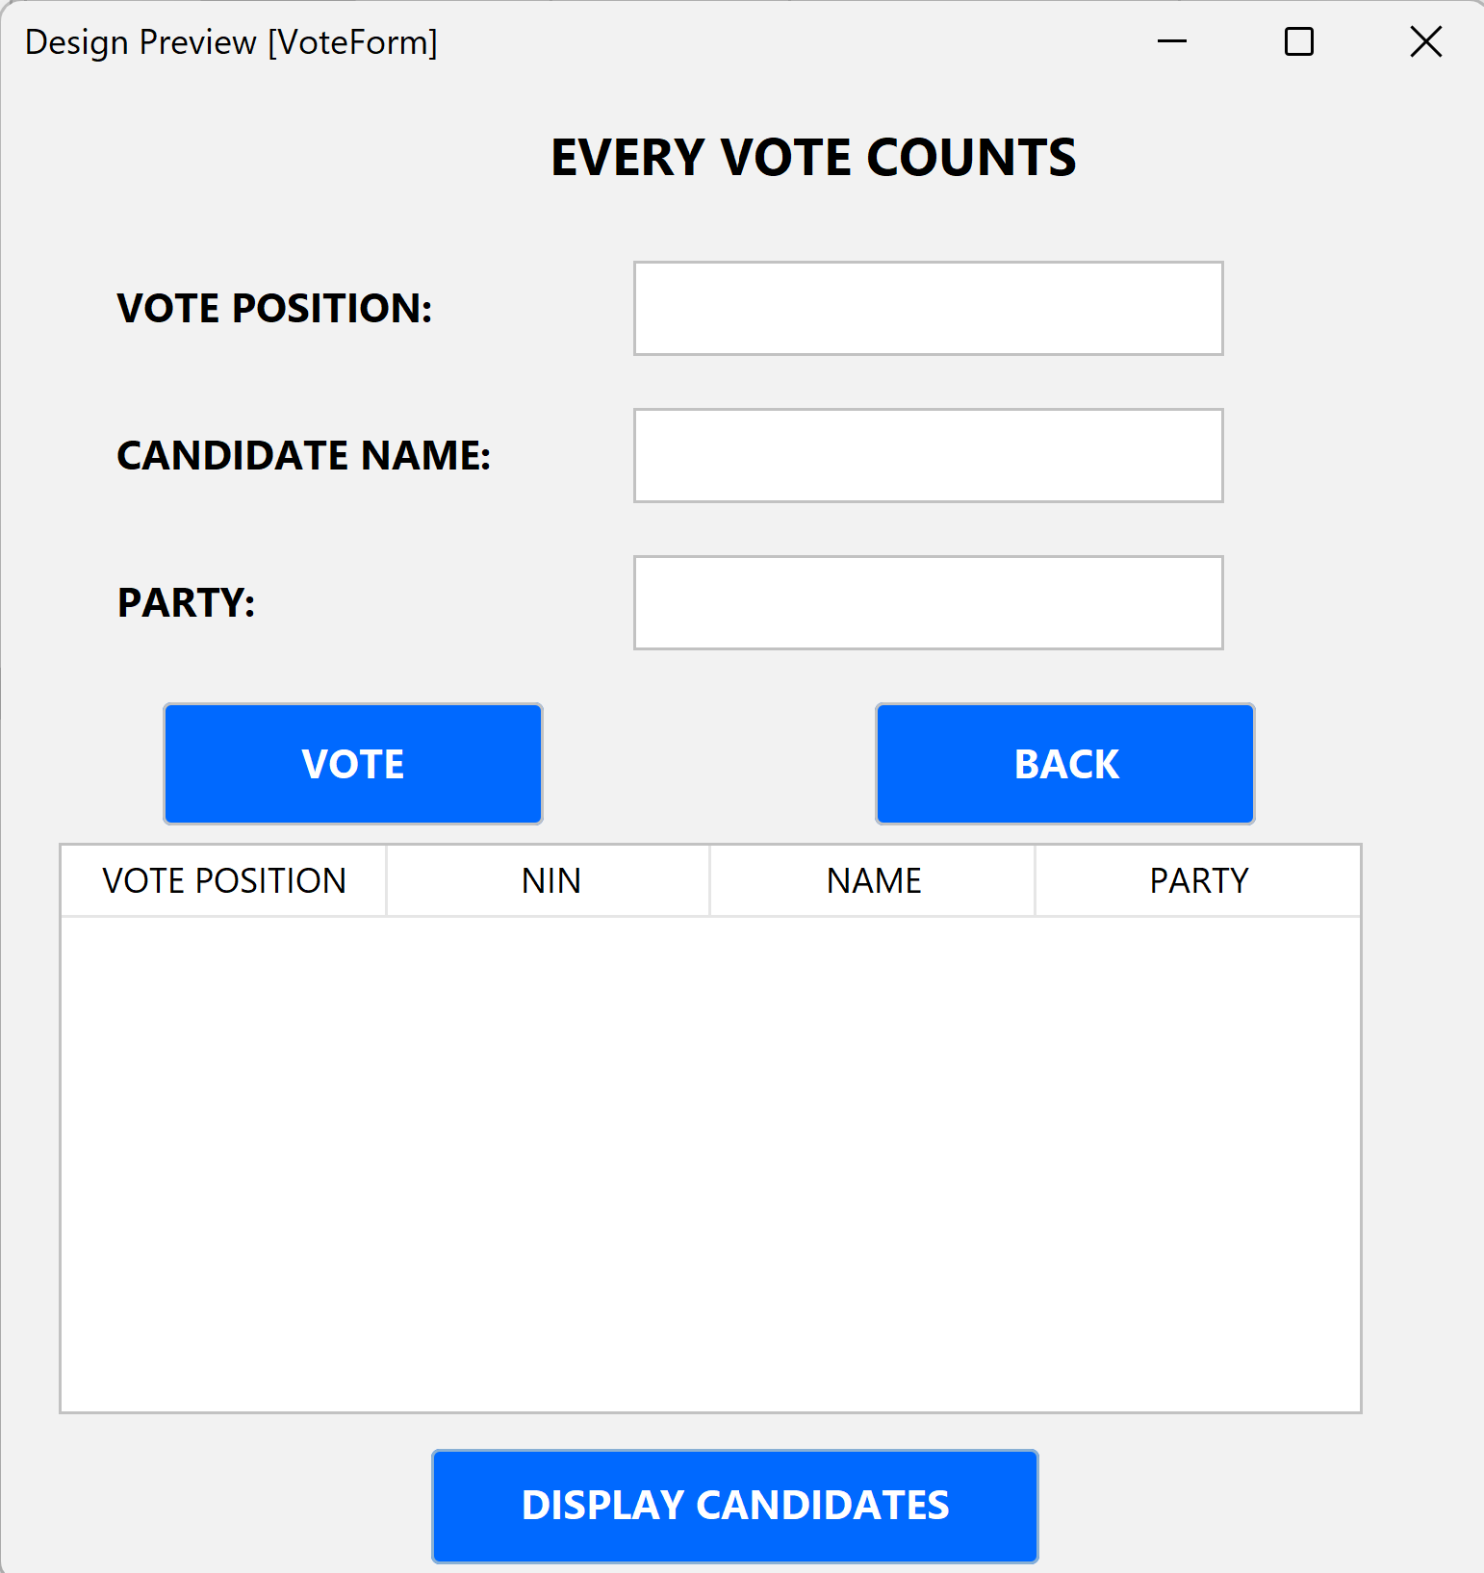
User Interface Model
The Vote Form Page is a simple as the Voter Register page.
It has a display candidates button that displays a table of candidate details that are to be used while voting.

Slide 9
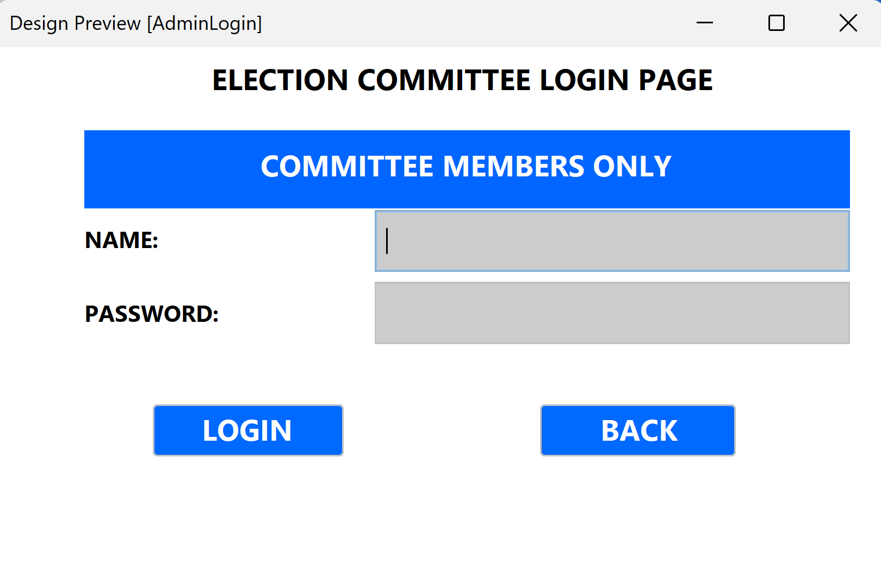
User Interface Model
The Admin Login Page is a simple as the Voter Register page.
It has a Login button that checks the database for admins with matching details.

Slide 10
Backend Processing Module
This manages the voting authentication, vote submission and tallying process. It ensures accurate and efficient vote counting.
It includes a secure vote submission that is once a voter registers, they only get one chance to vote and if its an invalid vote, they can’t adjust that.
Real time tallying system: Votes are tallied from the moment they’re cast.
Scalable Architecture: This system can handle increasing amounts of data and users.

Slide 11
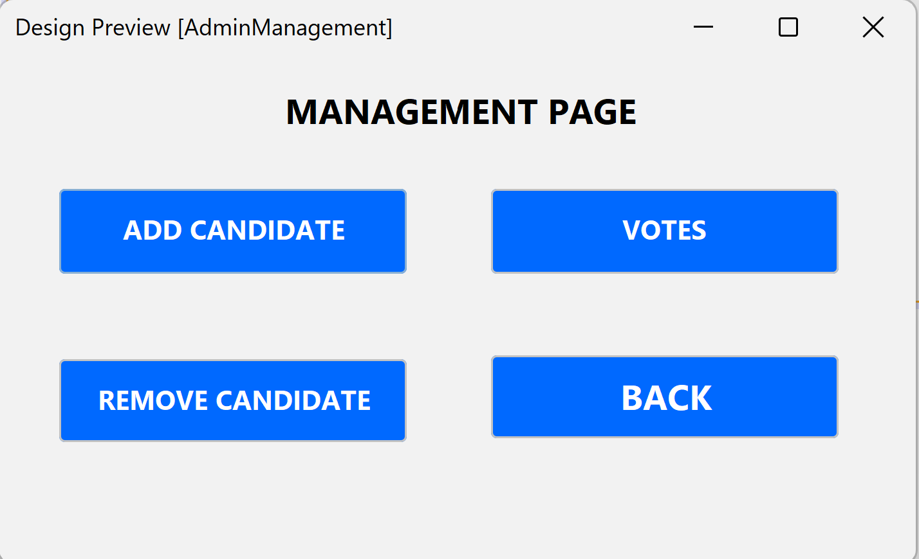
Administrative Module
This allows only authorised officials to manage the voting process. That is setting up elections, adding candidates and reviewing results.
Real Time monitoring dashboard on your right.

Slide 12
3
Flowchart

Slide 13
Components
The flowchart provides a visual representation of the voting system's workflow, showing the sequence of steps from user login to vote tallying.
Start: The Process Begins
User Login:
User Enters needed Information
System then verifies it. If wrong you re-enter
Candidate Selection: User selects candidate from the list
Casting Vote: User submits vote
Votes Confirmed: System the tallies votes
End: The Process Ends

Slide 14
START
User Registration
Yes
Proceed to Vote
Is User above 18 years?
Vote Tallying
No
Display Current Results
STOP

Slide 15
4
Database Design

Slide 16
Database Design
Candidates Table:
Election ID (Primary Key), National ID (Unique), Name (Unique), Party.
Voters Table:
National ID (Primary Key), Name (Unique), Gender, Age.
Votes Table:
Election ID (Foreign Key), Name , Party.

